Slide 1
Provide Insights to Management in Consumer Goods Domain
Domain : Consumer Goods
Function : Executive Management
Challenge :
Atliq Hardwares (imaginary company) is one of the leading computer hardware producers in India and well expanded in other countries too.
However, the management noticed that they do not get enough insights to make quick and smart data-informed decisions. They want to expand their data analytics team by adding several junior data analysts.
Task :
Check ‘ad-hoc-requests.pdf’ - there are 10 ad hoc requests for which the business needs insights.
We need to run a SQL query to answer these requests.

Slide 2



Consumer Goods Ad Hoc Insights

Slide 3
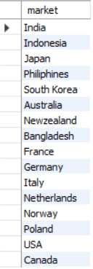
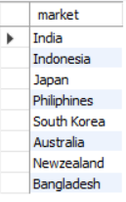
Customer
Provide the list of markets in which customer "Atliq Exclusive" operates its business in the
APAC region
Over all Region APAC Region

Slide 4
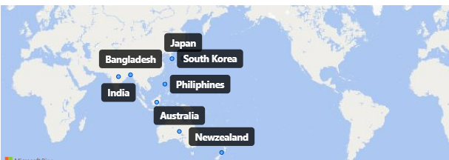
The list of markets in which customer "Atliq Exclusive" operates its business in the APAC region are Japan, South Korea, Bangladesh, India, Philippines, Australia and New Zealand
India – Maximum Sales
Japan – Minimum Sales

Slide 5

Product Count 2020 vs 2021 What is the percentage of unique product increase in 2021 vs. 2020 ?

Slide 6
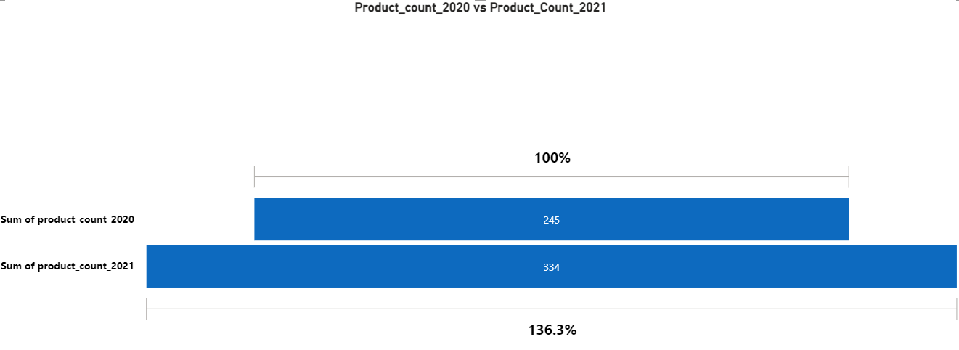
The unique product count in 2020 is 245
The unique product count in 2020 is 334
The Count difference is 89
The percentage of unique product in 2020 vs 2021 is 36.3%

Slide 7
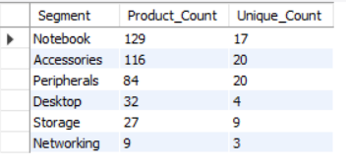
Segment Count
Provide a report with all the unique product counts for each segment and sort them in descending order of product counts

Slide 8
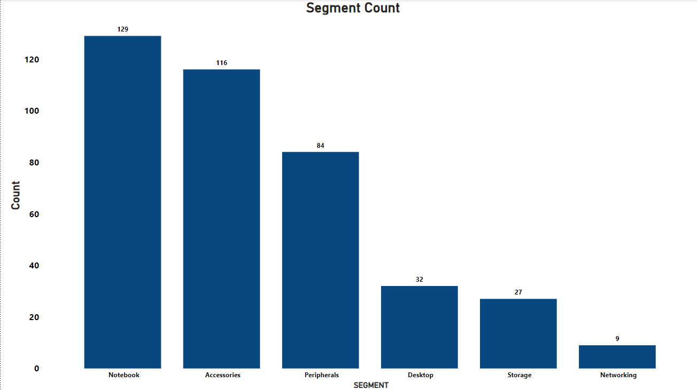

Slide 9
Notebook is the top segment and Networking is the least segment based on their product count
If we considered unique products counts for segment then the Notebook and Peripherals are the top in their count
Network has the least count based upon the product count and unique count of product

Slide 10
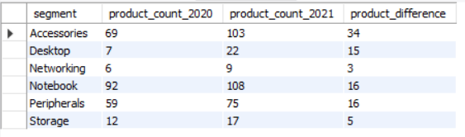
unique products Which segment had the most increase in unique products in 2021 vs 2020?

Slide 11
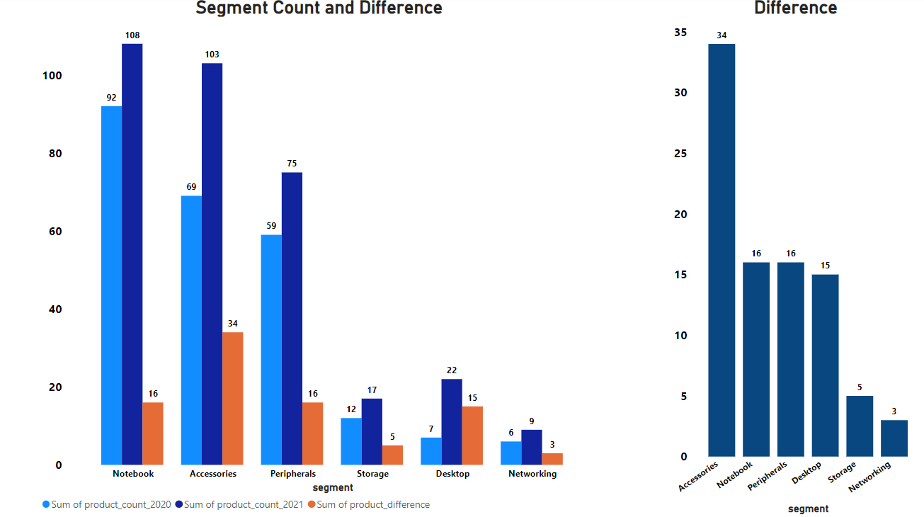

Slide 12
Based on Segment the Notebook contains the Highest ant the Networking contains the least product count in the Year of 2020 and 2021
But the Product count difference in the year of 2020 vs 2021
The segment
Accessories – Highest Product count
Networking – Least Product count

Slide 13

manufacturing costs Get the products that have the highest and lowest manufacturing costs.

Slide 14
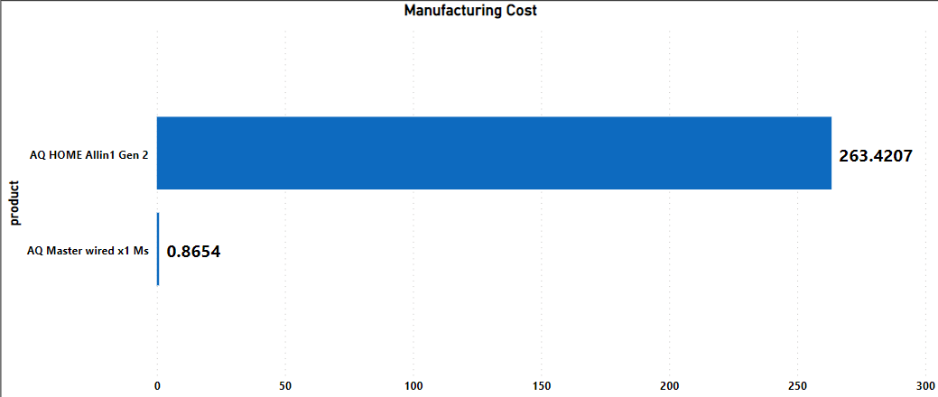
The Product AQ HOME Allin 1 Gen 2 contains the maximum manufacturing cost and
The Product AQ Master Wired x1 Ms contains the minimum manufacturing cost

Slide 15
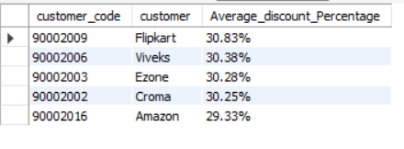
Discount Generate a report which contains the top 5 customers who received an average high pre invoice discount pct for the fiscal year 2021 and in the Indian market.

Slide 16
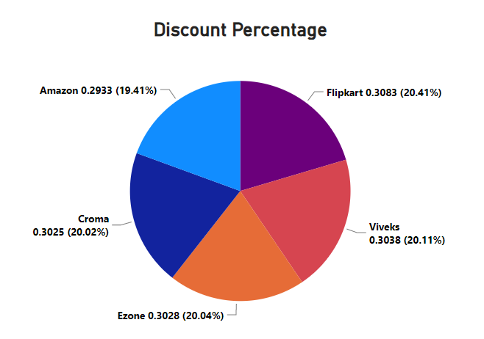
Flipkart has the Highest Discount Percentage
Amazon has the Least Discount Percentage
Flipkart, Viveks, Ezone and Croma are differ in the Percentage by decimal values

Slide 17
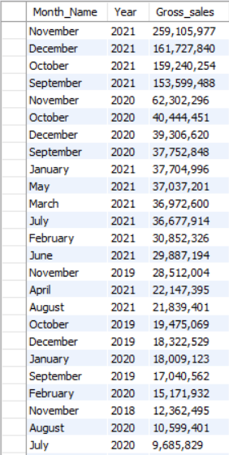
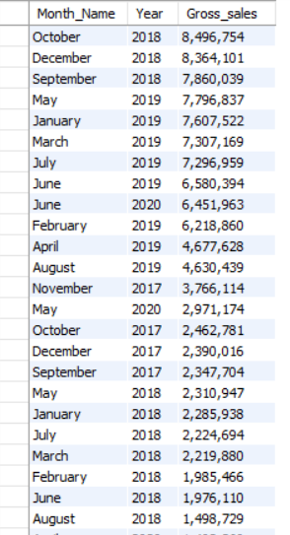

Gross sales amount Get the complete report of the Gross sales amount for the customer “Atliq Exclusive” for each month. This analysis helps to get an idea of low and high-performing months and take strategic decisions

Slide 18
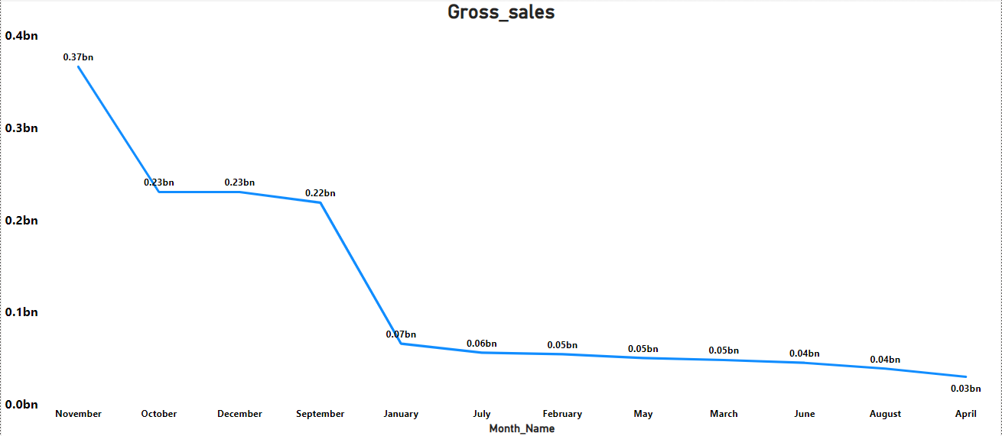
Based upon the month wise
The month of November has the highest Gross Sales amount and
The month of April has the Lowest Gross Sales amount
In the Year of 2021 the month from September to December contains Highest Gross Sales amount
In the year of 2018 the month from January to August contains the Least Gross Sales amount

Slide 19
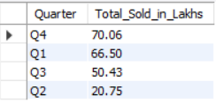
Sold Quantity In which quarter of 2020, got the maximum total sold quantity?

Slide 20
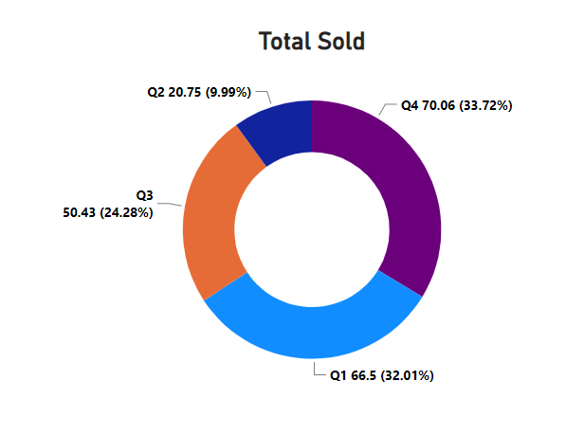
In the quarter of 4 got the maximum total sold quantity (around 34%) and
In the quarter of 2 got the minimum total sold quantity (around 10%)

Slide 21
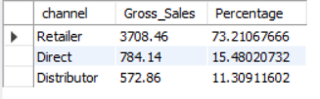
gross Sales percentage Which channel helped to bring more gross sales in the fiscal year 2021 and the percentage of contribution?

Slide 22
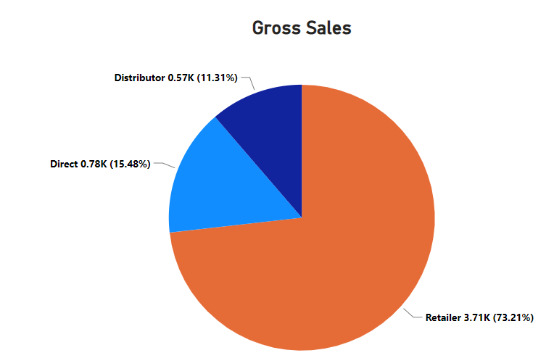
The channel Retailer helped to bring more gross sales in the fiscal year 2021 and the percentage of contribution is 73.21%

Slide 23
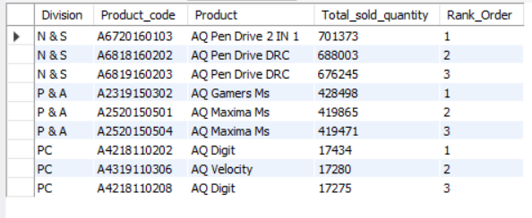
top products Get the Top 3 products in each division that have a high total sold quantity in the fiscal year 2021?

Slide 24
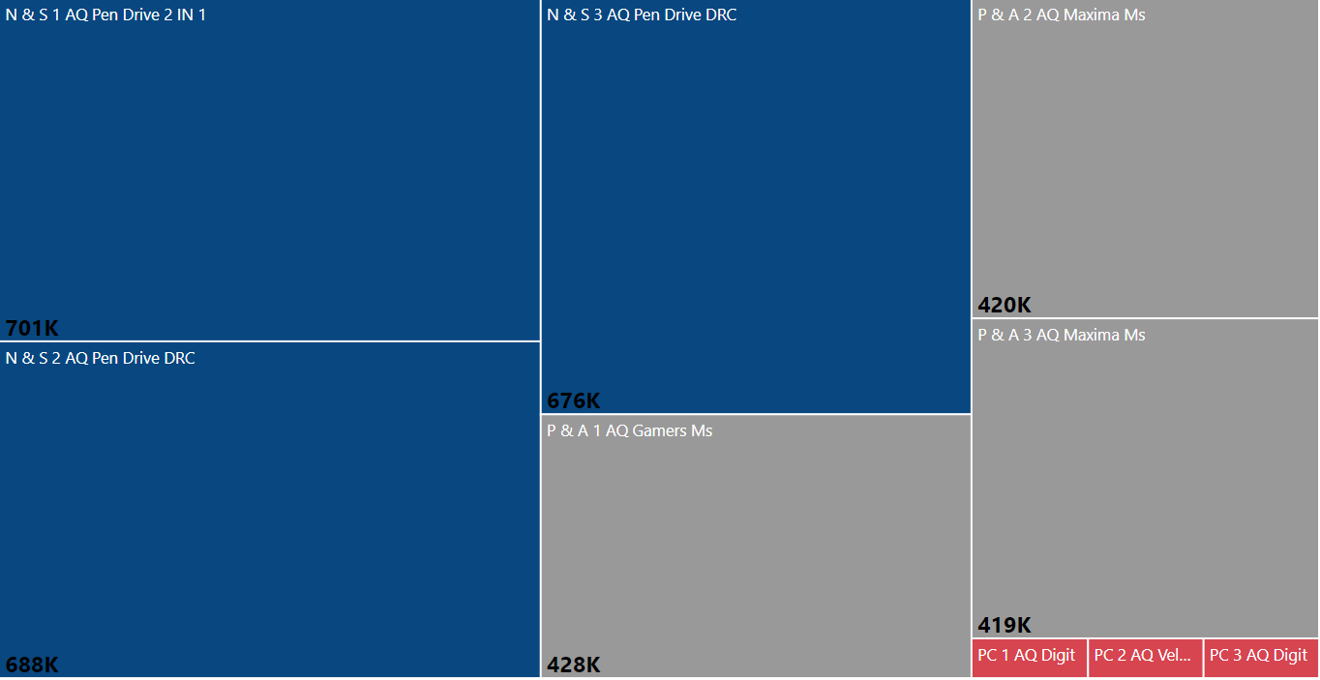

Slide 25
In the case of N & S division, the top three products sold are AQ Pen Drive 2 IN 1, AQ Pen Drive DRC, and AQ Pen Drive DRC. In the P & A division, the top three products sold are AQ Gamers Ms, AQ Maxima Ms, and AQ Maxima Ms. And in the PC division, the top three products sold are AQ Digit, AQ Velocity, and AQ Digit.
Overall, this data provides a high-level view of the top-selling products in each division, which could be useful for identifying trends, evaluating performance, and making business decisions.

Slide 26
Thank you
Santhosh s

